Slide 1
Brand Management
The final PowerPoint presentation should be max. 5 slide describing briefly
(1) the task
(2) the input/output
(3) all steps taken (process flow diagram)
(4) the main problems for each step
(5) the (meaningful) ways to improve your projects furthers if you would have gotten more time
• Please send us your final presentation by Monday, 27/04/2020, 18:00. • We only accept a single PPTX file as attachment. • Add slide notes to EVERY slide of the PPTX file. These slide notes should contain your complete script for your talk. Further, include in this email the following 3 links: • A link to your deployed data product on Google App Engine, Microsoft Azure, Heroku, … • A link to a ZIP file on www.wetransfer.com, which contains all scripts and data of your data product. Please include a detailed step by step tutorial how to install all requirements and how to run the analysis locally. • A link to GitHub where the code for your application can be found. As some datasets might be too large, you can upload/use only a sample for this. Please ensure that your code still runs with this sample. After receiving your presentation, we will generate videos based on these files (like the video lectures on deep learning), upload these videos to YouTube (unlisted, thus only people with the link can find them), and send the links to the videos to all seminar participants. If you are curious how your text will sound, you can test it in advance by using the widget on the following homepage: https://cloud.google.com/text-to-speech. Further, we plan on sending the links of the deployed prototypes to all seminar participants. Next, we will setup individual video meetings with each group to give us a live demo of their project. Thus, please block the following date/time in your calendar: • Group “Brand Management”: Thursday, 30/04/2020, 11:00 • Group “Recommender“: Thursday, 30/04/2020, 13:00 • Group “Product Shots”: Thursday, 30/04/2020, 15:00
Visual Listening: Extracting Brand Image Portrayed on Social Media
21 April 2020 - Zurich
Neeraj Kumar | Linda Samsinger | Theebana Rajendram | Vincent Rüegge
Notes:
Welcome to our presentation of the project about Visual Listening or Extracting Brand Image Portrayed on Social Media.
The task of this project was to build a tool to analyze the brand image of a company based on user-posted images on social media.
This involves replicating a study done by Liu, Liu and Dzyabura, Daria and Mizik, Natalie, about Visual Listening In: Extracting Brand Image Portrayed on Social Media (Feb 27, 2020). Available at: https://ssrn.com/abstract=2978805 .
Our team members consists of Neeraj, Linda, Theebana and Vincent. Neeraj formed a deep learning architecture for automating image classification of annotated Flickr images as either being healthy, natural, fun, rugged or not.
Linda on the other hand was responsible for streamlining the project across Github’s version control platform and testing the trained model on infinite scroll downloaded Instagram images as well as passing the results over to the web app framework.
Theebana’s tasks involved designing the power point presentation, merging dataframes of American apparel and beverage brands and downloading additional Flickr images for 10+ attributes.
Vincent set up the web app framework for model deployment. For this, he worked his way through json requests, python-to-javascript conversions, HTML5, CSS, and bootstrap methods, imports from different functions in all our notebooks online, and coordinated the transition to the web-interface.

Slide 2
Agenda
AI4Marketing
Introduction
Benefits of a Brand Management Web Tool for Marketing Personnel
Design of the Deep Learning Model Architecture
From Image Data to Model Deployment on a Web Application
Problems and Improvements
How to use Deep Learning for Marketing?
Notes:
This presentation consists of 5 slides, one slide for each key point about the project we are trying to make.
First, in our introduction we give a general overview of the project. This includes what the project was about, the WHY, the approach we took, the HOW, and the result of the project, the WHAT.
We realized that the goal of this project follows the dicates of marketing strategies and are essentially engrained in making corporate branding and identity work for a wide public clientele. This is why:
Second, we outline project goal’s marketing benefits.
In an effort to provide an easy-to-use analytic tool for brand managers a machine learning model was shaped.
Third, we explain how our deep learning architecture can be used to get noteworthy statistical results from feeding in image data.
Forth, we take the opportunity to walk you through all the steps we took from getting the raw image input to the model deployment output on the web.
Finally, we will take a moment to discuss the problems we faced during the whole process and what we did to resolve them. An outlook of what can be done in the future will close off this presentation.

Slide 3



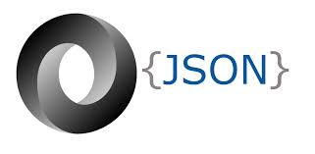

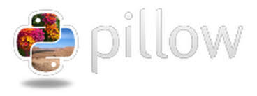






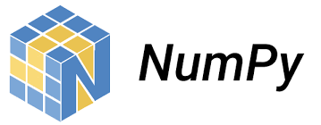
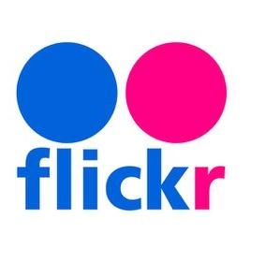


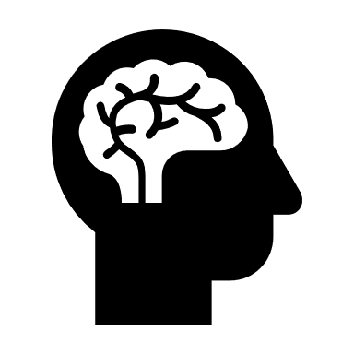
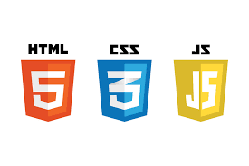
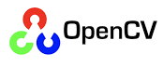
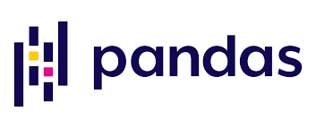
Introduction
DL4Marketing
Task: Build an AI-powered Web App to categorize images of official and unofficial #brand profiles on social media into 4-12 predefined brand personality attributes (BPA) Approach: supervised machine learning (feed in BPA-tagged Flickr images, tweak a deep learning model that combines convoluational layers with a softmax classifier for visual brand analysis, test model with Instagram images)
Web App: statistical profile analysis for a #brand
Social Media | BPA
Flickr, Instagram | fun, healthy, rugged, glamorous
Request
Web Application
Response
Model Prediction
Deep Learning Model
Key in brand name: official + unofficial social media profile
Get Social Media Brand URL
Classification of one brand at a time into fixed brand attributes
How to use Deep Learning for Marketing?
Notes:
The group’s main task was to build a deep learning model that would learn how to classify any web 2.0-sourced images into brand personality attributes such as fun, healthy, rugged and glamorous in the most accurate manner. On Flickr there exist attribute-labelled images that served as input to our pretrained deep learning model. Once improved over several lapses of training, the deep learning model predicted the attributes for images taken from a brand’s Instagram official profile and hashtag posts. We count the number of times the classifier predicted an attribute for all images of a particulare brand.
The frequencies in absolute and relative numbers are displayed on the web app to enable an analysis of the brand’s image on social media posts.

Slide 4
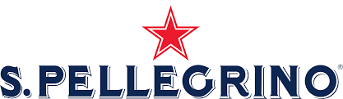
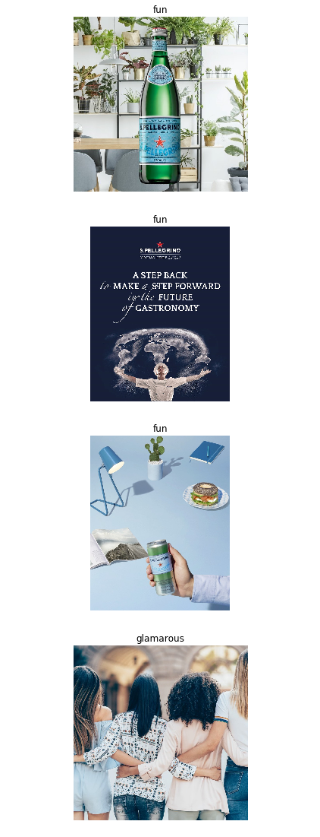
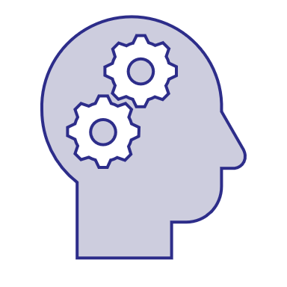

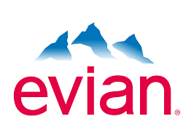

Benefits of a Brand Management Web Tool for Marketing Personnel
DL4Marketing
Consumer Insights - Better understand consumer brand perception
Benchmarking - Brand positioning and comparison with competitors
New Opportunities - Improve corporate brand image
San Pellegrino
Official portrayal is healthy 41% & fun 54%.
Unofficial portrayal is healthy 70% & fun 21%.
sanpellegrino_official:
#sanpellegrino:
San Pellegrino vs. Evian
Unofficially, Evian (35%) less healthy than
San Pellegrino (70%). Officially, San Pellegrino
(41%) less healthy than Evian (59%).
San Pellegrino
«Marketing department to revise its 5-year brand positioning plan to focus on strenghtening its brand’s health benefits in advertising and social media campaigns.»
How to use Deep Learning for Marketing?
Notes:
From a marketing perspective, brand management is centered around the three fundamental pillars of consumer insight, benchmark comparing and laying out new opportunities. Using these commercial instruments, we use the case of the brand «San Pellegrino» to derive an evidence-based answer for devising a suitable marketing plan for the years to come.
The brand management tool should help brand account managers to better understand how their consumers perceive their brand.
For example, San Pellegrino’s officialy aims to come across as healthy and fun in the images they release on their Instagram channel at will. However, an unofficial take of their images reveals that their brand is not considered as fun as much as it is for being perceived as healthy. There is much more polarization in the unofficial brand perception than there is with the official image.
Typically, brands of the same market niche are competing for consumers to acknowledge their soft brand power.
Our webtool can be used to benchmark different brands for a cross-over, comparative analysis of brand personalities. For instance, San Pellegrino could be compared to Evian, an other fresh water supplier on the beverages market. We analyze both brand profiles to acknolwedge that unofficially, Evian is perceived as less healthy than San Pellegrino. However, officially, the reverse is true in both brands’ marketing efforts: San Pellegrino falls back less on making their brand appear healthy than Evian.
Also, boosting the coporate image should not go without reliance on a solid analysis of one’s brand’s standing in its respective market sector.
To push our example of San Pellegrino official vs. unofficial even further, we could imagine San Pellegrino planning to ramp up their stocks of corporate perception after consulting our web tool and changing to underscore their ‘healthy’ brand image in their upcoming marketing publications.

Slide 5
Design of the Deep Learning Model Architecture
DL4Marketing
OneVsRest Multiclass Image Classification Problem
Classified manually annotated 16.000 images downloaded from Flickr using Linux-on-Windows into one of the following 4 attributes (+ their antonyms + UNK classes) taking the argmax probability :
Transfer Learning Approach
Used pre-trained «ResNet50» model (CNN) with 500k parameters and added our own last fully connected classifier layer.
Model Prediction
Predicted class label for brand images.
Example: Brand «DAR-VIDA»
Fun | Healthy
Glamorous | Rugged
Input: Brand Image
Output: Class Label
How to use Deep Learning for Marketing?
Notes:
TODO @ Neeraj
Machine Learning: build classifiers for each attribute using supervised learning & a pre-trained self-designed deep learning Convolutional Neural Network framework

Slide 6
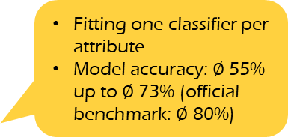
From Image Data to Model Deployment on a Web App
DL4Marketing
Resize images to same dimensions (300,300)
Remove corrupt images
Label antonym negatives for attributes
Data augmentation
1
2
Labeled
Flickr
Images
Data Preprocessing
3
4
5
Train-Test-Validation Split: 80:10:10
One-vs-Rest approach: multiclass classification used where each classifier was trained independently for the corresponding attribute in the dataset
Train
Validate
Test
6
7
Fitting one classifier per attribute
Model accuracy: $∅$ 55% up to $∅$ 73% (official benchmark: $∅$ 80%)
Unlabeled
Instagram
Images
Label Classifier Model
8
9
Model Prediction
Web Application
How to use Deep Learning for Marketing?
Notes:
TODO
one vs rest approach of multiclass classification, we need to create 4 classifiers one for each attribute.

Slide 7
Limitations and Improvements
DL4Marketing
Back-end development: tested model on images sourced with Github Instagram API, application still pending for Pinterest API on Pinterest Developers
Downloaded 23.2 GB worth of Flickr images, 1000 for all 12 attributes (+8) using Java/ shell script, made infinite scroll possible for sourcing Instagram images, copyright/licenses/royalties, bypass video URLs, age-limited http request blockages
Enlarged pipeline throughput: ameliorated model accuracy (or F1-score) to 91.13% for attribute «healthy», but necessitates complexity vs. slimmed-down model design for user-friendliness and fast computing results
Trained Model reiterations: changed approach from one model to OneVsRest models, used different pretrained models resnet50, resnet100, and vgg16 and weights, batch-trained, in the future use multilabel instead of multiclass, size models up through cross-validation
Front-end development: solved naming idiosyncrasies of official Instagram brand accounts, saved images to variable not onto user’s desktop client
Tentative deployment on Google App Engine, portability across browsers, responsive design, UI/UX design, user traffic, multimedia document embedding
How to use Deep Learning for Marketing?
Notes:
TODO
Besides Flickr and Instagram, we considered getting images from Twitter and Pinterest. In our discussion about Twitter and Pinterest, we realized that Pinterest would be the better platform to source images because of the image content they supply which is much more straightforward and tightyl linked to the keyword searched than on Twitter. Efforts towards getting the Pinterest API were made, but the application is still pending as of now.
Extending the original brand personality attributes, fun, healthy, rugged and glamorous to twelve more attributes were based on the eight standard brand personality categories found in the marketing literature: calm, cheerful, confident, creative, exciting, fiery, happy, intelligent, natural, reliable, strong, wholesome. Each of these attributes can be mapped to one category such that one category does not have more than two attributes. In total, we have sixteen attributes up and running.
Another challenge we faced was video posts on Instagram brand profiles instead of images, 16/18 or 21-year-of-age limit that blocked access to the Instagram posts and the official brand’s Instagram account name that could be anything from sanpellegrino_official to gap_usa. This is the reason why we considered to provide only brands that are listed in a dataframe and no other brands. But finally, we chose to let the user look up the exact Instagram account name of their requested brand by themselves. Only then will the user be able to start a search request on our web tool online.
Another issue we need to consider is respecting user’s rights when downloading copyrighted content or not using images/videos from Instagram for commercial intent. Although the web tool is meant for commercial use, the project’s outer make-up will make any real-world commercialization of the final product a less likely probability.
The reason we could not deploy the webtool on the Google App Engine is because of a time-out '502 bad gateway' error or a credit card details demand that could not be satisfied due to personal reasons. Also, our model is too large to deploy it on Heroku.
Our preset time horizon did not allow us to follow up on our mock-ups, nevertheless we tentatively considered a multimedia document embedding for our webtool – showing both official and unofficial Instagram images with predicted labels on a separete website. But this would have required a databank back-up for which we would not have the time to see it through to the end. Also priority was given to make the deep learning model workflow as good as possible.

Slide 8
Thank you for listening!
Neeraj Kumar | Linda Samsinger | Theebana Rajendram | Vincent Rüegge
Notes:
With this, we have come to the end of our presentation about the project we have been working on for the last couple of weeks. We have learned a lot about image processing, python and java programming, finding workarounds, web scraping, deep learning models, API management, the Github universe, and web programming. Thank you.
Should you have questions about our project, please to not hesitate to ask them in the follow-up section.
Thank you for your attention.

